Slide 1
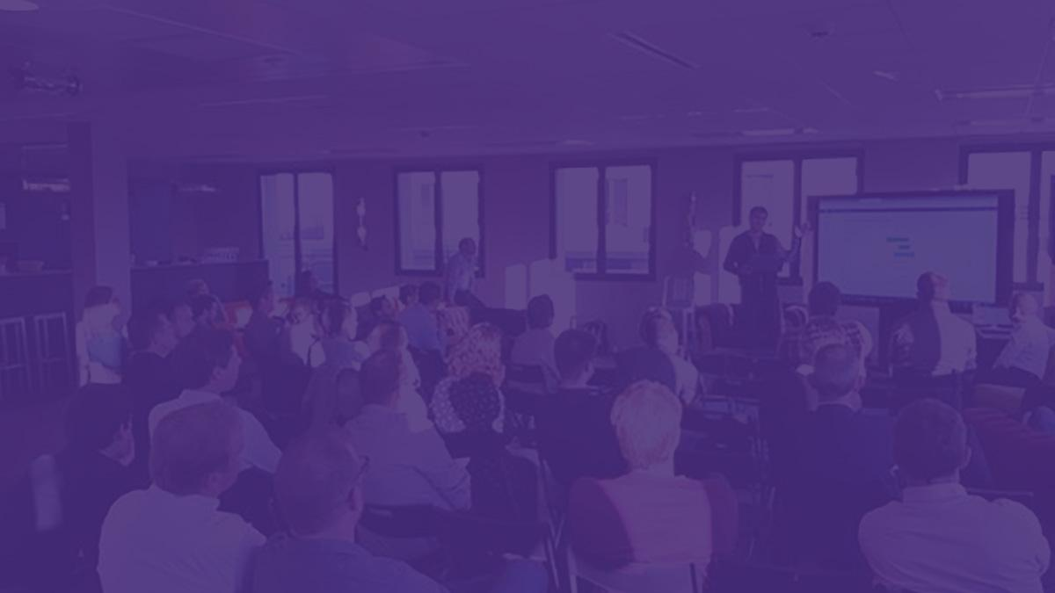


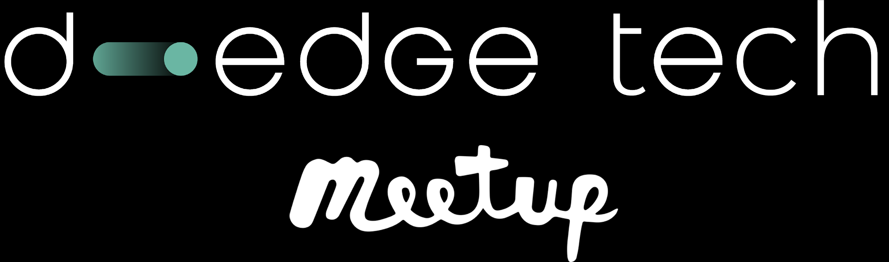
Hi!
Timothé Larivière
Software Engineer at D-EDGE Fabulous Maintainer Microsoft MVP
TimLariviere
@Tim_Lariviere

Slide 2
Making Mobile App Development simple
with F# and Fabulous

Slide 3
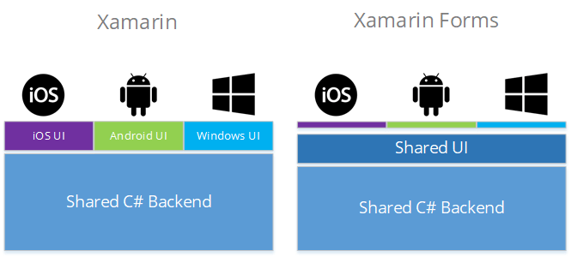
.NET mobile development
Xamarin: Native mobile development with .NET
Xamarin.Forms: Shared UI written in XAML, rendered as native controls at runtime
Tailored for Object-Oriented Programming (C#)
Static views
Relies on mutability
Hard to ensure state consistency

Slide 4
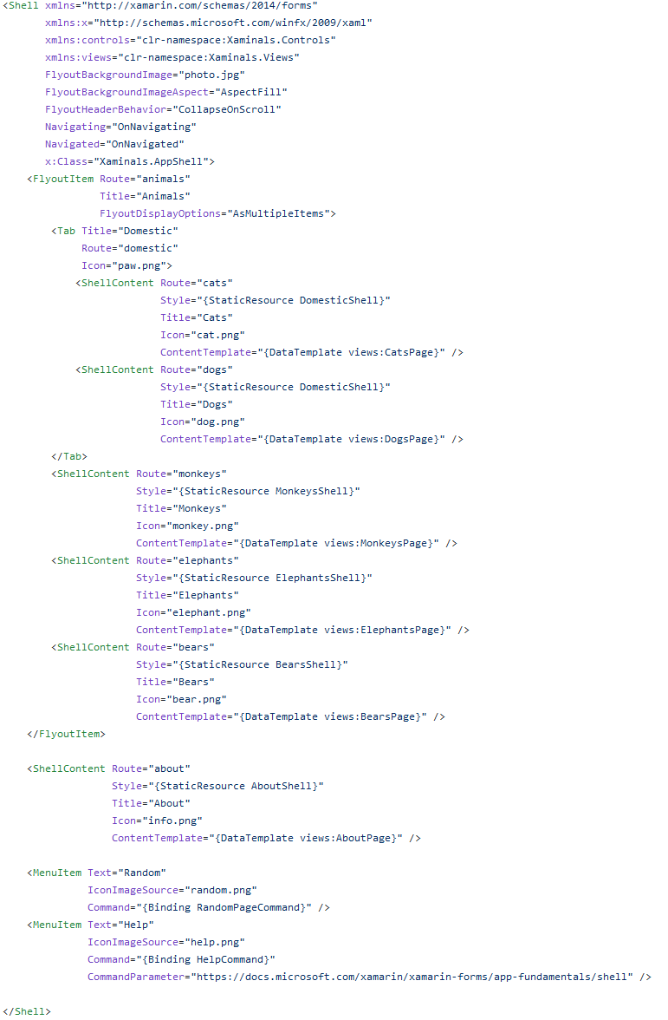
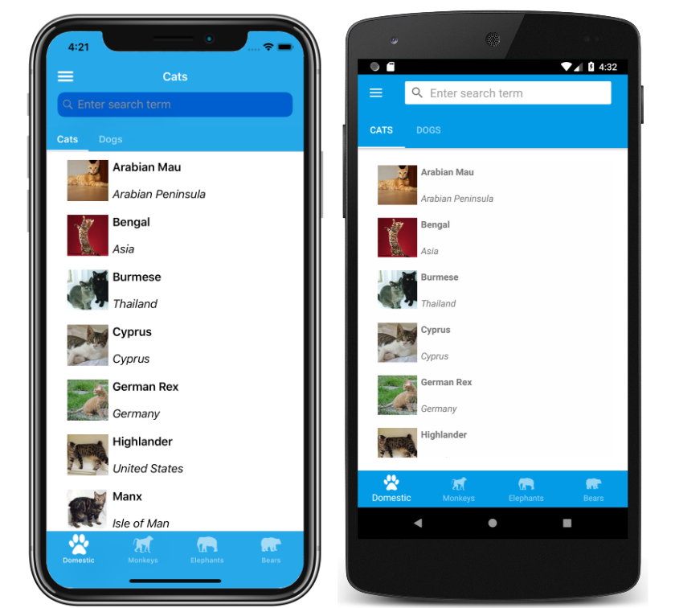
Xamarin.Forms
iOS
Android

Slide 5
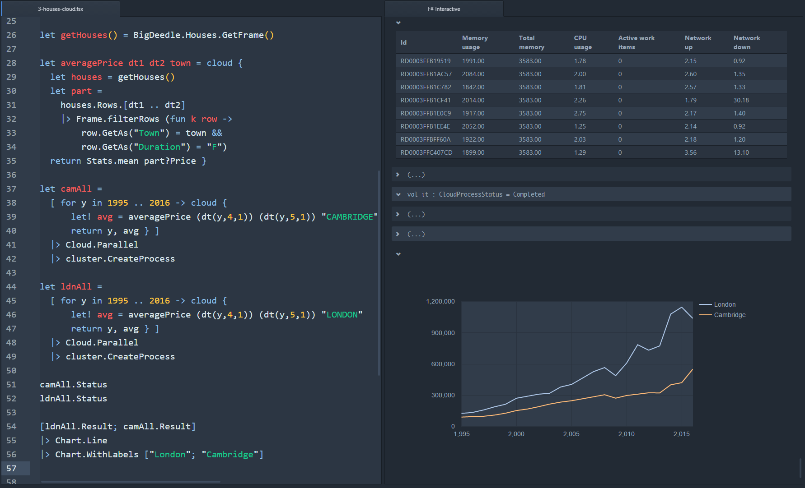
F#
Functional-first programming language
Multi-paradigm
Part of .NET
Immutability by default
Non-nullability by default
Expressions instead of statements
Source: http://tomasp.net/blog/2016/fslab-ionide/

Slide 6
F# is great for everyone
Contrary to popular belief, FP is not hard to learn
OOP requires way more knowledge before being efficient (many design patterns)
Today, “good code” already uses many functional concepts

Slide 7
F# is great for everyone
More concise: less noise, type inference
More reliable: no null by default, immutability, pure functions, etc.
Richer type system: discriminated unions, records, pattern matching, etc. (all slowly being added to C#, albeit with some inconsistencies)

Slide 8
What is Fabulous?

Slide 9

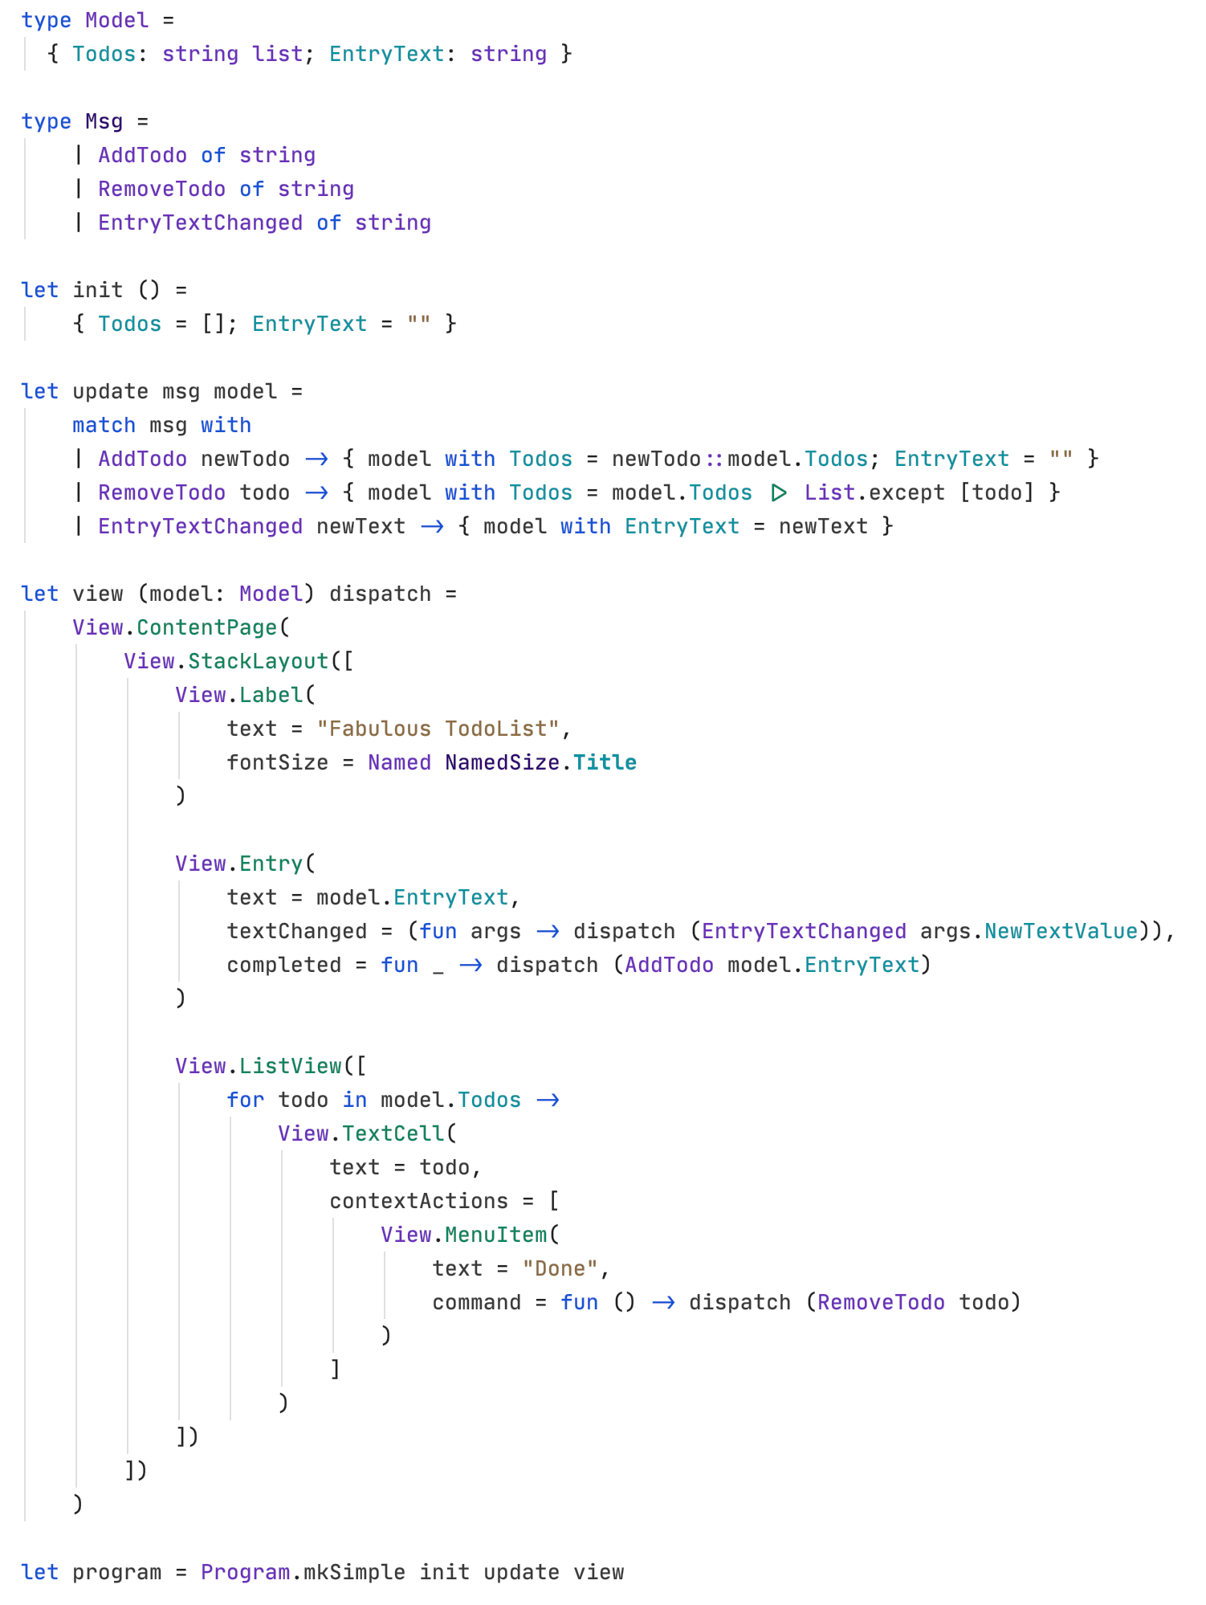
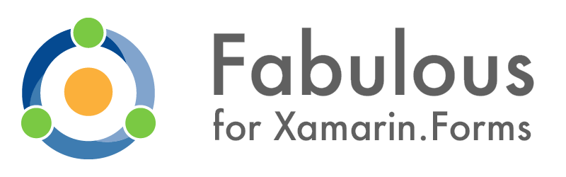
https://github.com/fsprojects/Fabulous
Brings Functional Programming to existing .NET desktop & mobile frameworks
Model-View-Update (MVU) architecture
Declarative UI programming
Complete app in one single language: F#
See your changes without restarting your application with LiveUpdate

Slide 10




Let’s build an app!
dotnet new -i Fabulous.XamarinForms.Templates
dotnet new fabulous-xf-app --name MyFabulousApp
We only need 2 command lines to get started:
UWP
WPF
By default, the template targets Android and iOS.
WPF, UWP, macOS, and GTK available as optional arguments.
Docs: https://fsprojects.github.io/Fabulous/Fabulous.XamarinForms
GTK#

Slide 11
MVU architecture

Slide 12
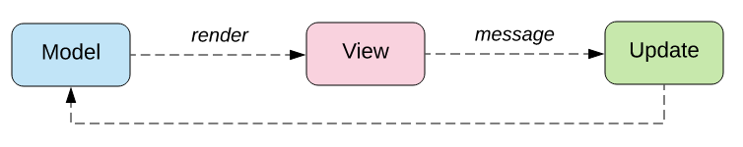
Model View Update
State (aka Model)
Messages
Init function
Update function
View function

Slide 13
MVU pros
Simple, yet powerful
Immutable state
Centralization & explicitness
No concurrency issues
Ease of testing

Slide 14
Demo: Christmas shopping list

Slide 15
Going beyond Hello World

Slide 16
Composability & Extensibility
Every single part can be composed: Models, Messages, UI
Bigger apps are like Russian dolls, little MVU “programs” can be composed together inside bigger MVU programs to make a full application
Fabulous provides wrappers for 1st party Xamarin.Forms controls
You can easily create wrappers for 3rd party controls, or even for your own controls

Slide 17
Prototyping & Testability
Prototyping is extremely fast with F# and Fabulous
Quick feedback loop
LiveUpdate
Code is 100% testable (example)
Only repeatable functions (no side effect)
Can load a pre-existing state at any time easily (app.SetModel(model))

Slide 18
Performance
Incremental updates
Caching and reuse of UI elements
Still have access to all Xamarin tools
Linker
Profiler
App Center, etc.

Slide 19
Showcases

Slide 20
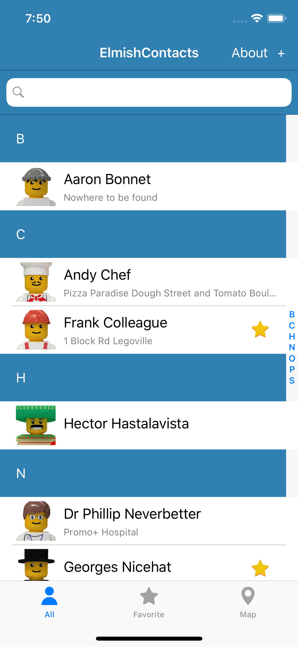
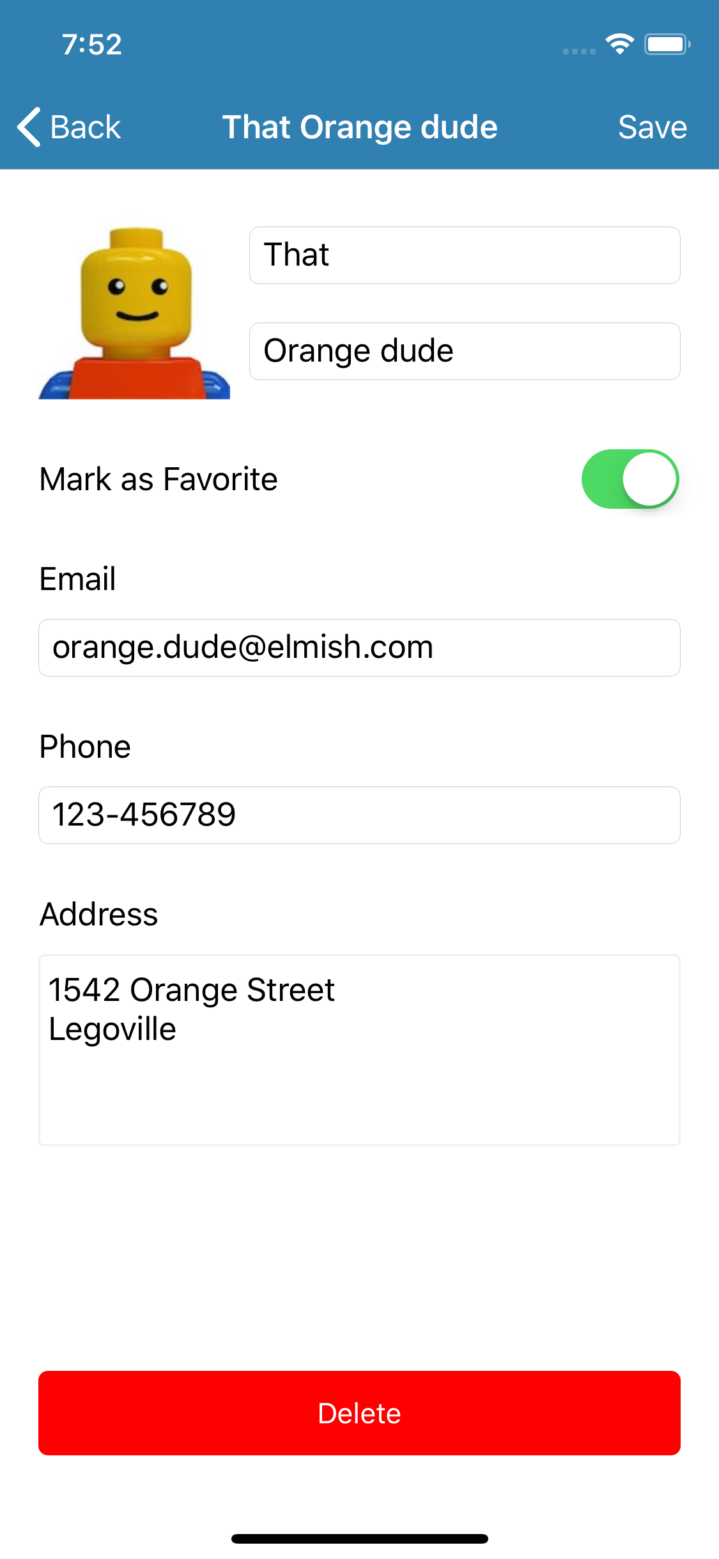
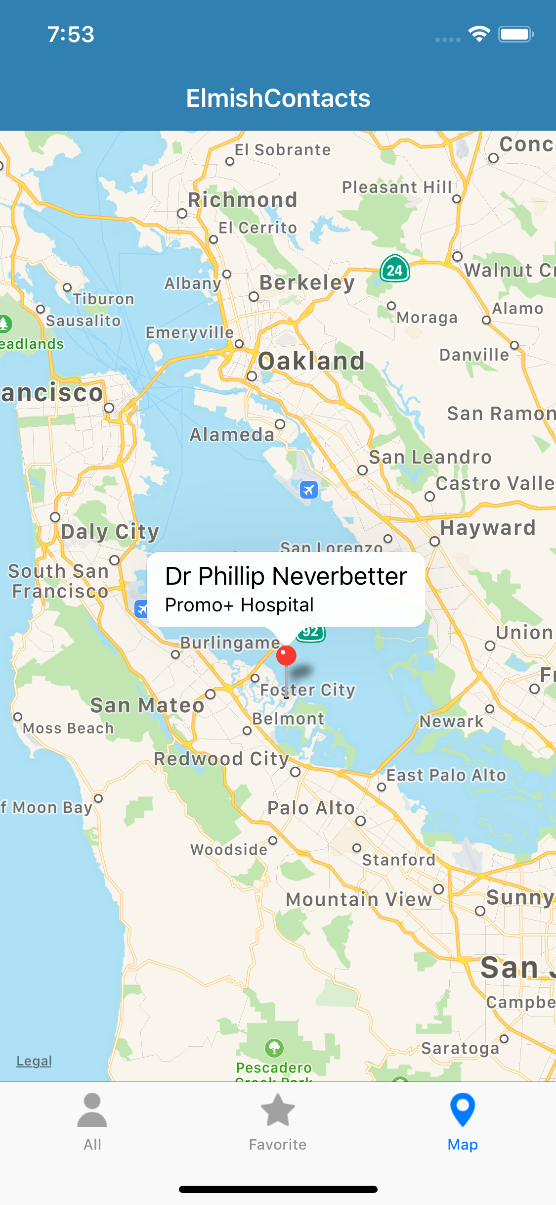
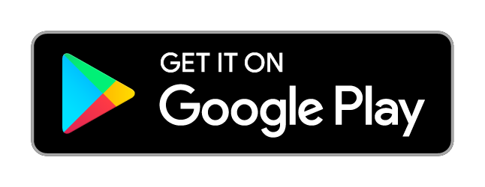

FabulousContacts
Contacts manager application
Real world-y sample
Multiple pages
Persistent storage: SQLite
Device APIs: Pictures, Maps, Geolocation
https://github.com/TimLariviere/FabulousContacts

Slide 21
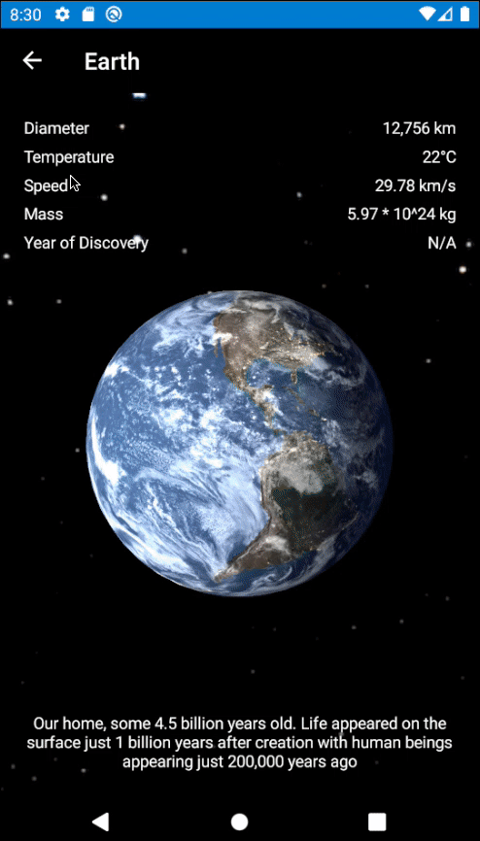
FabulousPlanets
Solar system planets explorer
Mix Fabulous and 3D with Urho3D
Show how to use 3rd party libraries inside Fabulous’ declarative UI
https://github.com/TimLariviere/FabulousPlanets

Slide 22
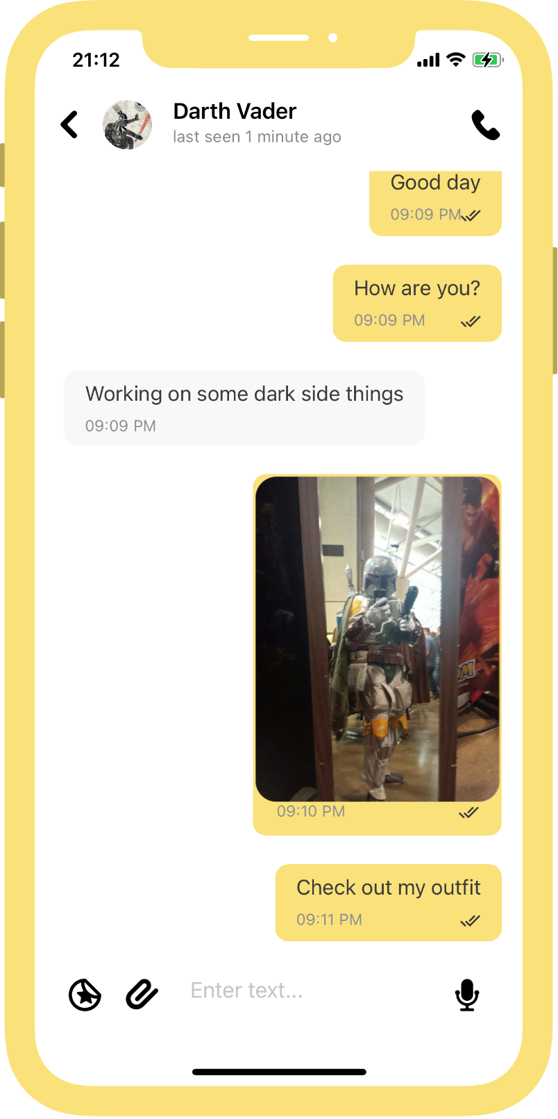
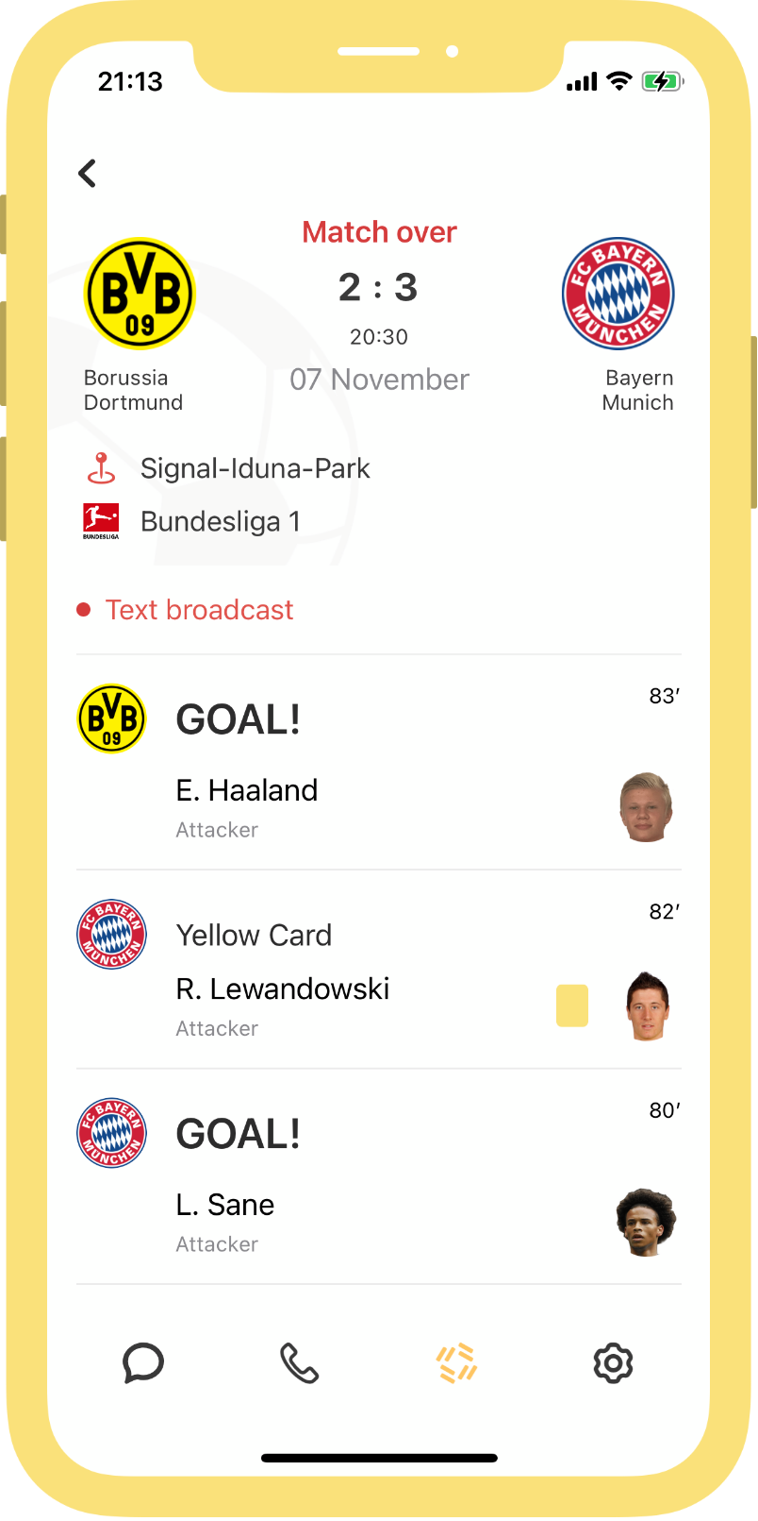
Tawasal
Messenger & super app, offering free voice, text, videoconferencing and lifestyle services to clients around the world
In production today!
www.tawasal.ae
Learn more: They use Fabulous

Slide 23
Contribute!
GitHub: https://github.com/fsprojects/Fabulous
Documentation: https://fsprojects.github.io/Fabulous/
Videos (Channel 9):
Introduction to Fabulous
Fabulous - Beyond MVU basics
Blog posts: https://devblogs.microsoft.com/xamarin/tag/fabulous/

Slide 24
Meetup organized by
D-EDGE combines technology and marketing to help hotels sell online and leverage the entire distribution chain.
With a team of 350 experts located in over 20 countries, D-EDGE provides localized support, services and tools to over 12,000 hotels.
With its global network of 500+ partners, D-EDGE’s ever-expanding ecosystem is a positive place for hotels to do business and grow.

Slide 25
Interested about D-EDGE?
Product Manager @ Barcelona
Tech Lead .NET @ Barcelona
Software Engineer .NET/JS @ Paris, Nantes or Bordeaux
More job openings at https://d-edge.welcomekit.co
silladjil@d-edge.com - Talent Acquisition Manager

Slide 26
Stay tuned for the next Meetup!
Planned for mid-January

Slide 27
Thank you!
www.d-edge.com

Slide 28

Any questions?

